Slide 1
SQL Case Study –
Steve’s Car Showroom

Slide 2
Overview
In this case study, we will analyze the provided data using SQL queries to answer Steve's questions and provide him with the required information.
The data is structured across three tables: salespersons, sales, and cars. The salespersons table contains information about the salesman ID, name, ages, and city. The sales table provides details about each sale, such as the sales ID, car ID, salesman ID and purchase date. The cars table contains information about the cars available, including car ID, car type, and other relevant details.
We’re tasked to find following insights :-
1. Details of all cars purchased in the year 2022.
2. Total number of cars sold by each salesperson.
3. Total revenue generated by each salesperson.
4. Details of the cars sold by each salesperson.
5. Total revenue generated by each car type.
6. The details of the cars sold in the year 2021 by salesperson 'Emily Wong’.
7. Total revenue generated by the sales of hatchback cars.
8. Total revenue generated by the sales of SUV cars in the year 2022.
9. Name and city of the salesperson who sold the most number of cars in the year 2023.
10. Name and age of the salesperson who generated the highest revenue in the year 2022.

Slide 3
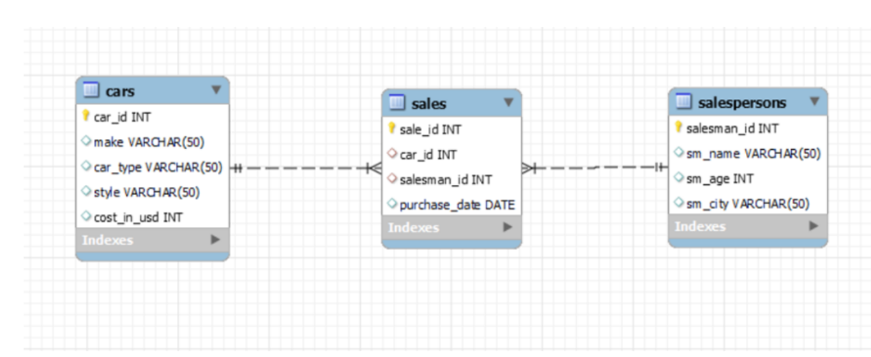
Schema

Slide 4
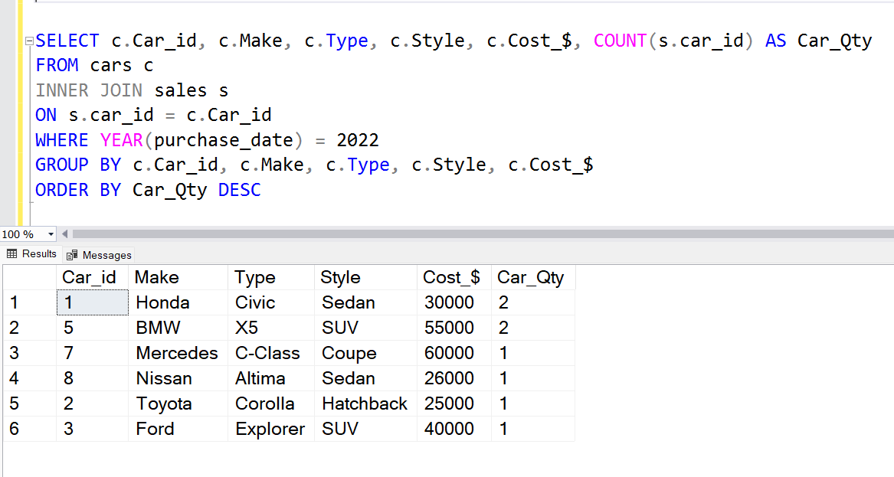
Insights
Details of all cars purchased in the year 2022.
It is found that 2 units Honda Civic and
BMW X5 are sold in the year 2022 while
only 1 unit of other cars has been sold.

Slide 5
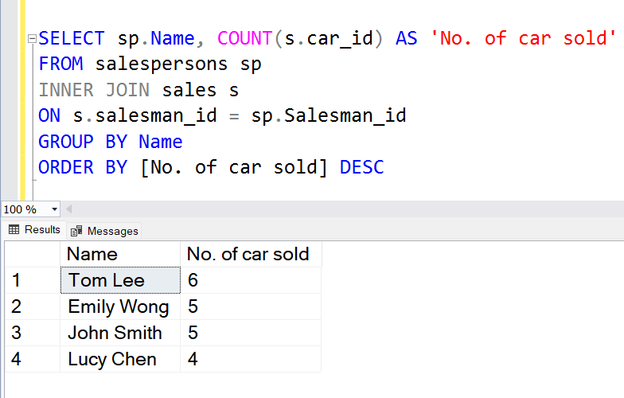
2. Total number of cars sold by each salesperson.
Tom Lee has sold the highest number of cars, while Emily Wong and John Smith have both sold an equal number of cars. On the other hand, Lucy Chen has sold the fewest number of cars

Slide 6
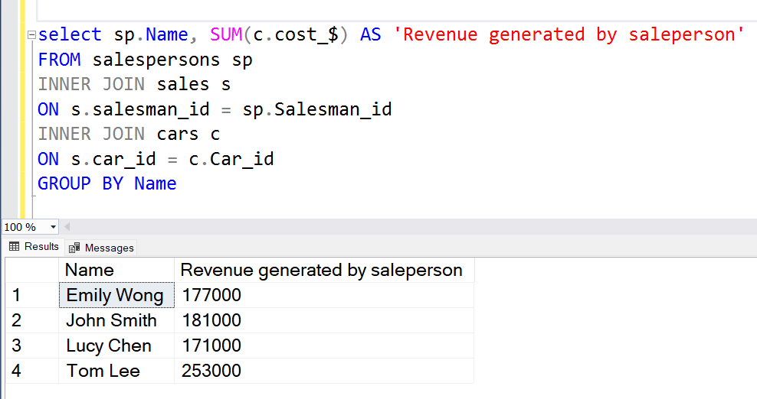
3. Total revenue generated by each salesperson.
The salesperson with ID 3 has generated the highest revenue of 253,000 USD, whereas the salesperson with ID 4 has generated the lowest revenue of 171,000 USD.

Slide 7
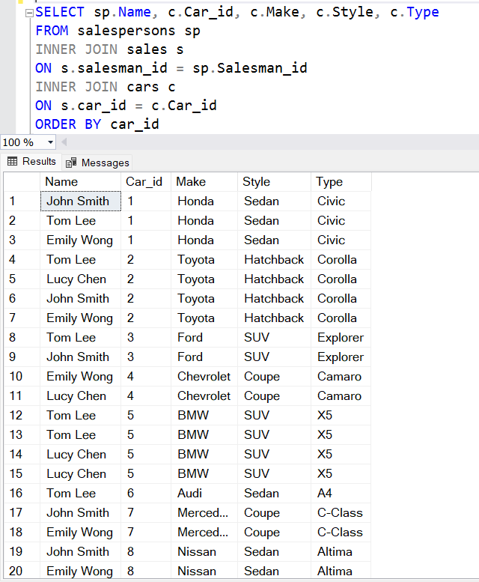
4. Details of the cars sold by
each salesperson.

Slide 8
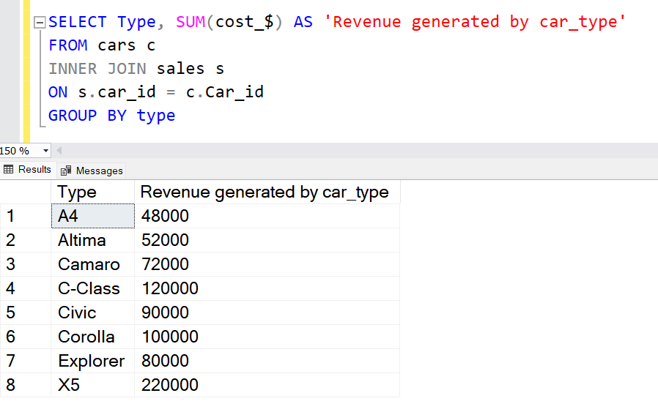
5. Total revenue generated by each car type.
The X5 car type has generated the highest revenue of 220,000 USD, followed by the C-Class and Corolla. On the other hand, the A4 has generated the least revenue.

Slide 9
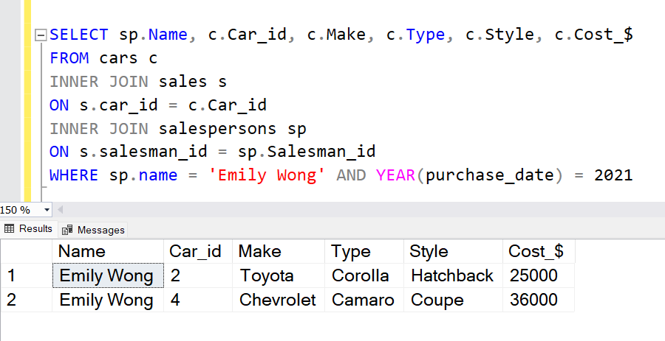
6. The details of the cars sold in the year 2021 by salesperson 'Emily Wong'.

Slide 10
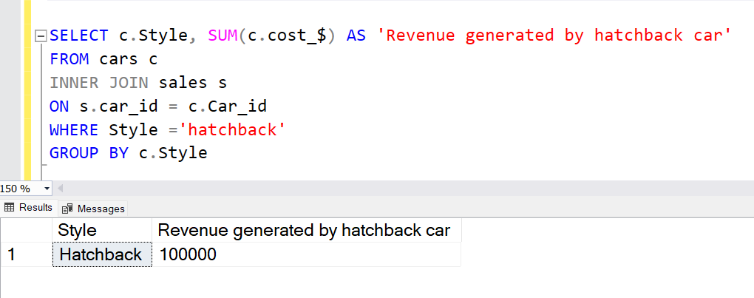
7. Total revenue generated by the
sales of hatchback cars.

Slide 11
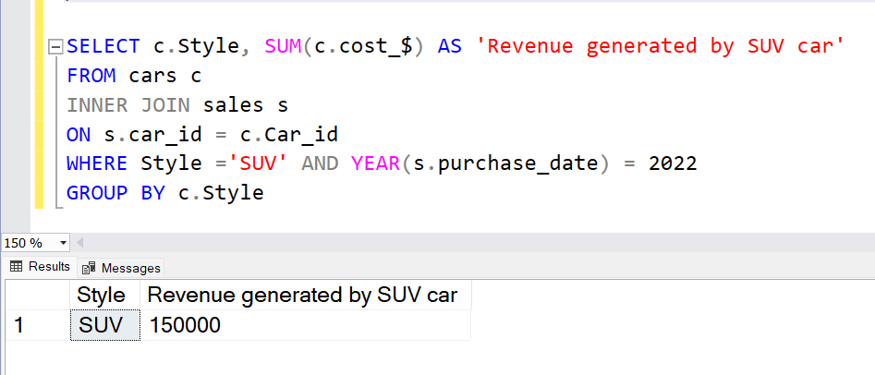
8.Total revenue generated by the
sales of SUV cars in the year
2022.

Slide 12
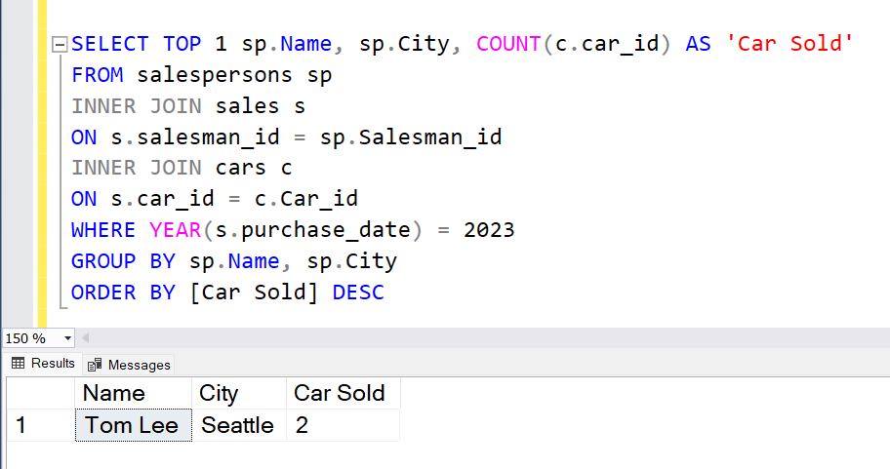
9. Name and city of the salesperson
who sold the most number of cars
in the year 2023.

Slide 13
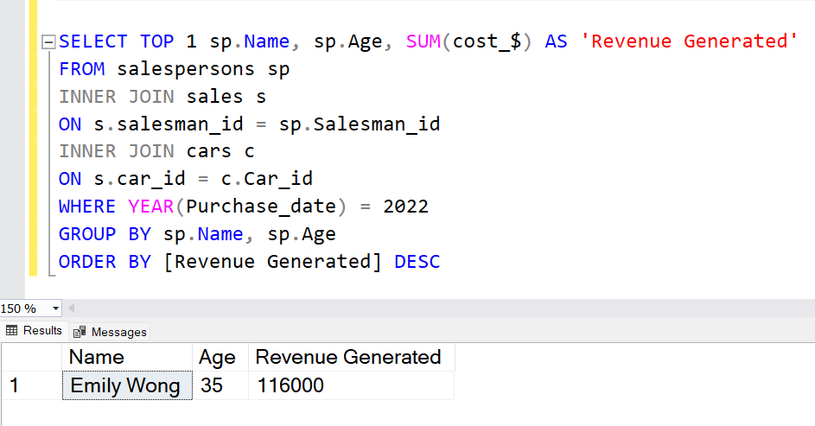
10. Name and age of the salesperson who generated the highest revenue in the year 2022.

Slide 14
Conclusion
In conclusion, this case study has provided me with valuable hands-on experience in SQL coding and expanded my knowledge of utilizing SQL for data analysis. Through this case study, I gained proficiency in data modeling and manipulation techniques. Moreover, it allowed me to explore advanced SQL concepts, including joins, aggregate functions, and date-time functions.
By analyzing the provided data using SQL queries, we’ve addressed Steve's questions and provided required insights. The analysis included information about cars purchased, salesperson performance, revenue generated, car details, car type revenue, specific salesperson details, and more. The results will assist Steve in making informed decisions and understanding the dynamics of his car showroom business.
Overall, this case study has been instrumental in strengthening my SQL skills, equipping me with the necessary tools to effectively analyze data and derive valuable insights. The hands-on nature of the case study has not only broadened my knowledge but also enhanced my confidence in utilizing SQL as a powerful tool for data analysis.

